Slide 1
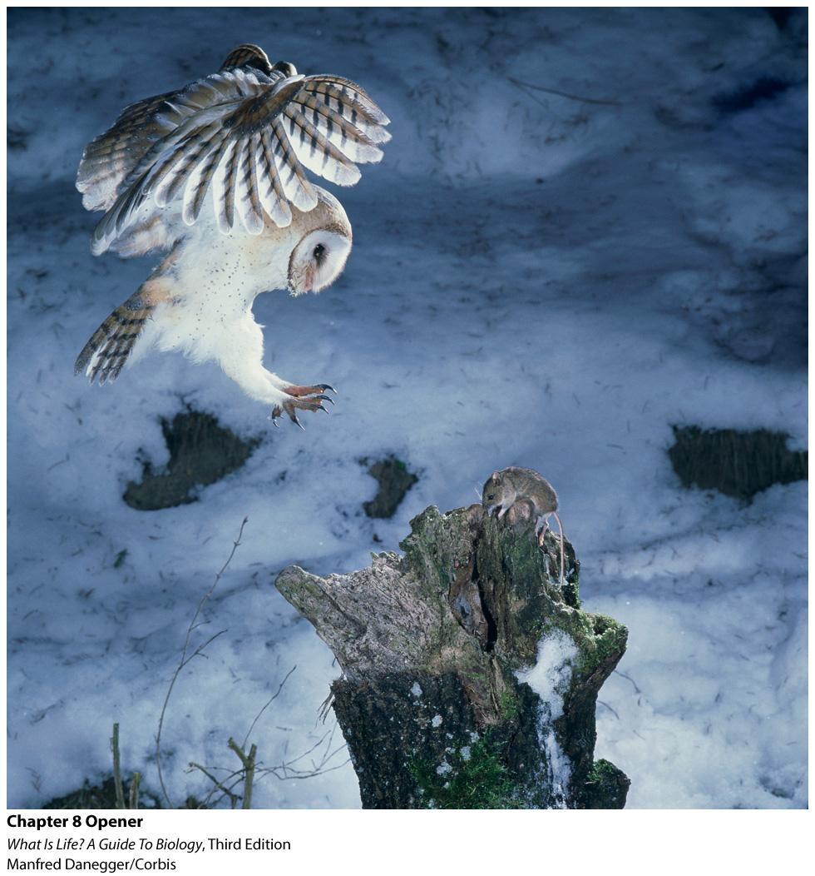
Evolution & Natural Selection
Darwin’s dangerous idea: evolution by natural selection
Notes:
‹#›

Slide 2
Give your opinion: “The human population is evolving.”
Strongly agree
Somewhat agree
Neutral/no opinion
Somewhat disagree
Strongly disagree

Slide 3
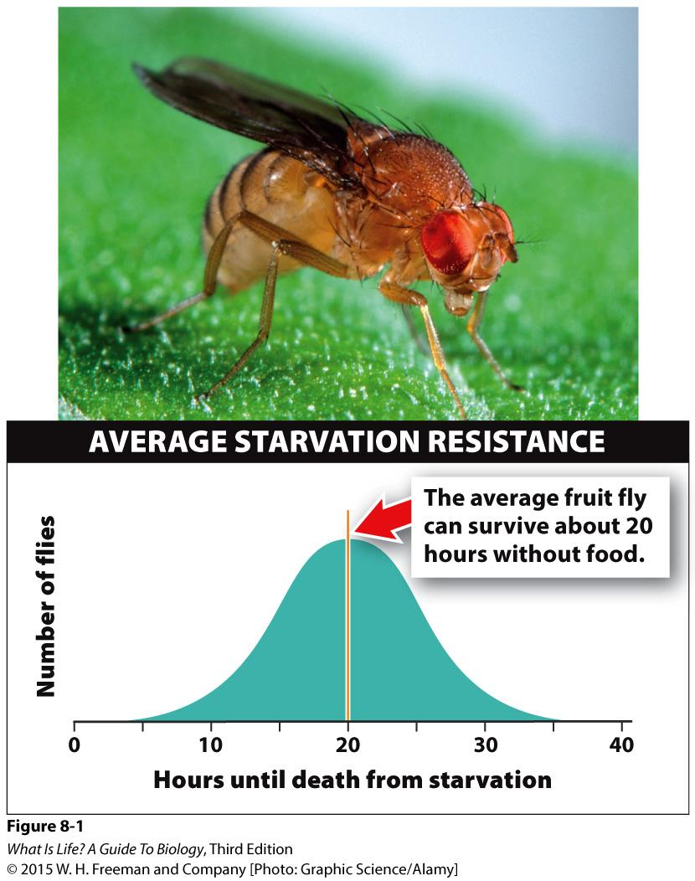
Evolution in Action
What is evolution?
Observe traits within a population
Could you breed fruit flies that could live longer than 20 hours on average?
Notes:
How long do you think a fruit fly can last without food?
The answer is just under a day. Twenty hours, give or take a few hours, to be more specific (Figure 8-1 Starvation resistance in fruit flies).
They can’t live long without food because their tiny bodies don’t hold very large caloric reserves.
But could you breed fruit flies who could live longer than 20 hours on average? The answer is: yes!

Slide 4
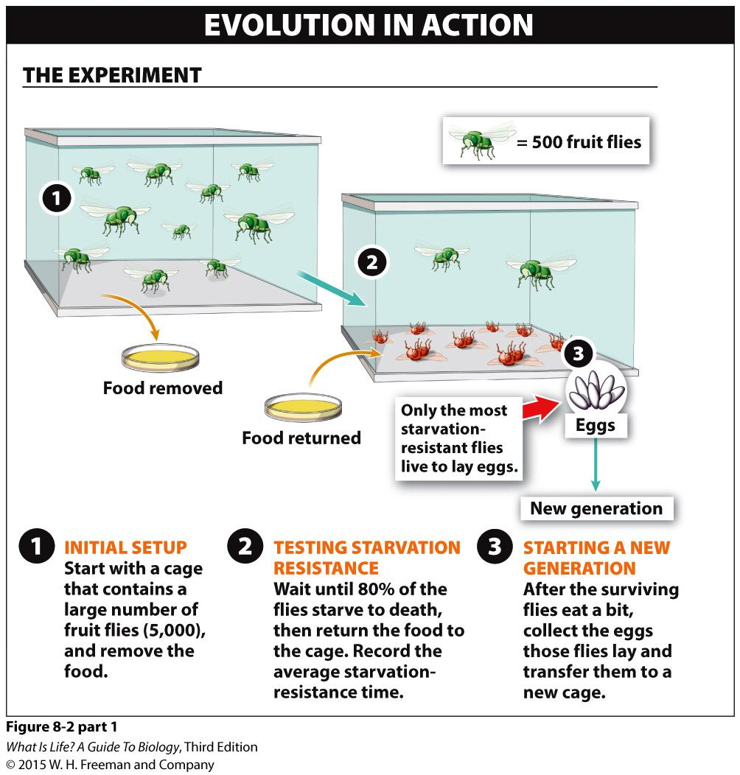
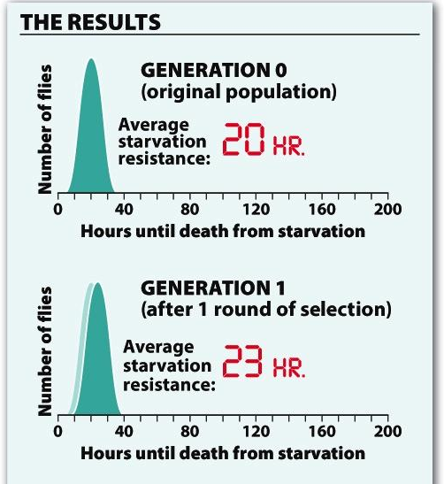
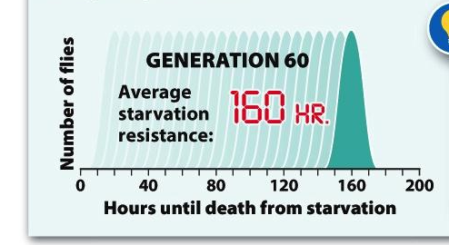
Notes:
Figure 8-2 (part 1) Evolution in action: increasing fruit fly resistance to starvation.
First, start with a population of 5,000 fruit flies.
In biology, the term population has a specific meaning: a population is a group of organisms of the same species living in a particular geographic region. The region can be a small area like a test tube or a large area like a lake.
In your experiment, your population occupies a cage in your laboratory.
From these 5,000 fruit flies, you choose only the “best” fruit flies to start the next generation, with “best” meaning the 20% of flies that can survive the longest without food.
Choosing these long-lived, hungry flies can be accomplished in three simple steps:
1. Remove the food from the cage with the population of 5,000 flies.
2. Wait until 80% of the flies have starved to death, then put a container of food into the cage.
3. After the surviving flies eat, they’ll have the energy to reproduce. When they do, collect and transfer the eggs to a new cage.

Slide 5
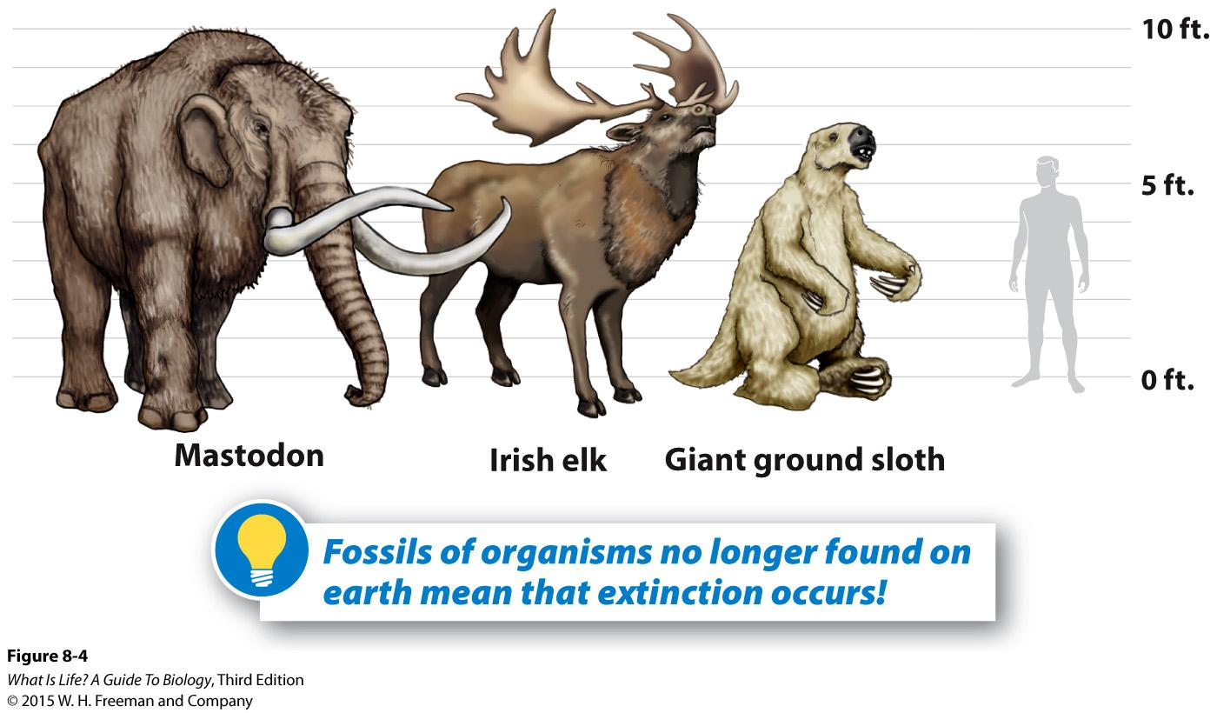
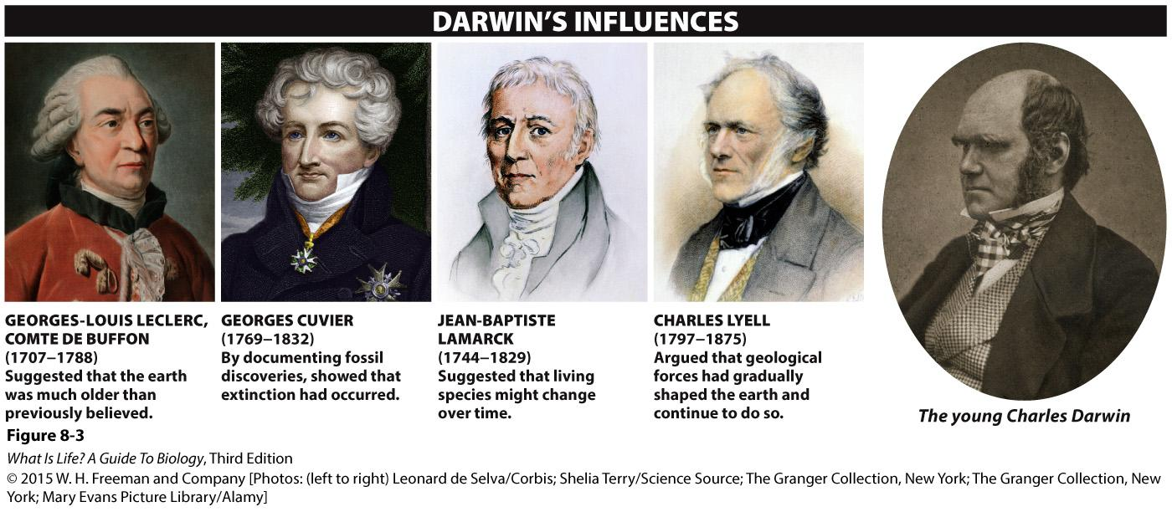
Darwin
Pre-Darwin, all religion
Wasn’t solely Darwin that changed people’s viewpoints
Notes:
Charles Darwin grew up in an orderly world. In the Victorian British society he inhabited, many beliefs about humans and our place in the world had changed little over the previous two centuries. Biblical explanations were sufficient for most natural phenomena: most people thought the earth was about 6,000 years old. And with the occasional exception of a flood or earthquake or volcanic eruption, the earth was believed to be mostly unchanging. People recognized that organisms existed in groups called species or kinds.
People in Darwin’s society also generally believed that all species, including humans, had been created at the same time and that, once created, they never changed and never died out.

Slide 6
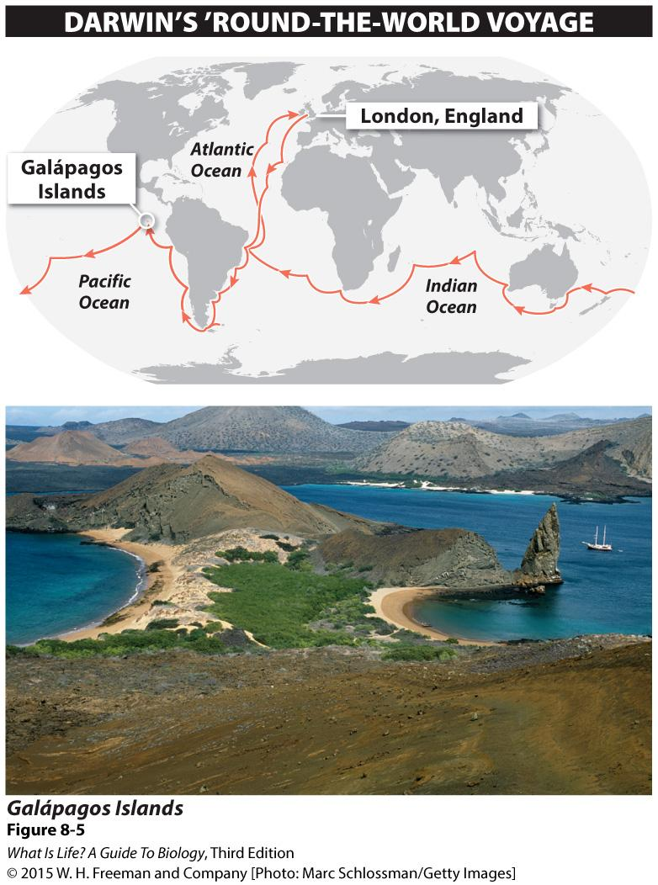
Darwin’s Journey
Age 16, University of Edinburgh, medical studies
Studied theology at Cambridge University
His real love: study of nature
Traveled on the Beagle
Notes:
At 16, Darwin went to the University of Edinburgh to study medicine, following his father’s footsteps. He was bored, though, and left at the end of his second year.
Darwin then pursued the ministry, studying theology at the University of Cambridge.
Shortly after graduation in 1831, Darwin landed his dream job, a position as a “gentleman companion” for the captain of HMS Beagle, on a five-year, ’round-the-world surveying expedition.

Slide 7
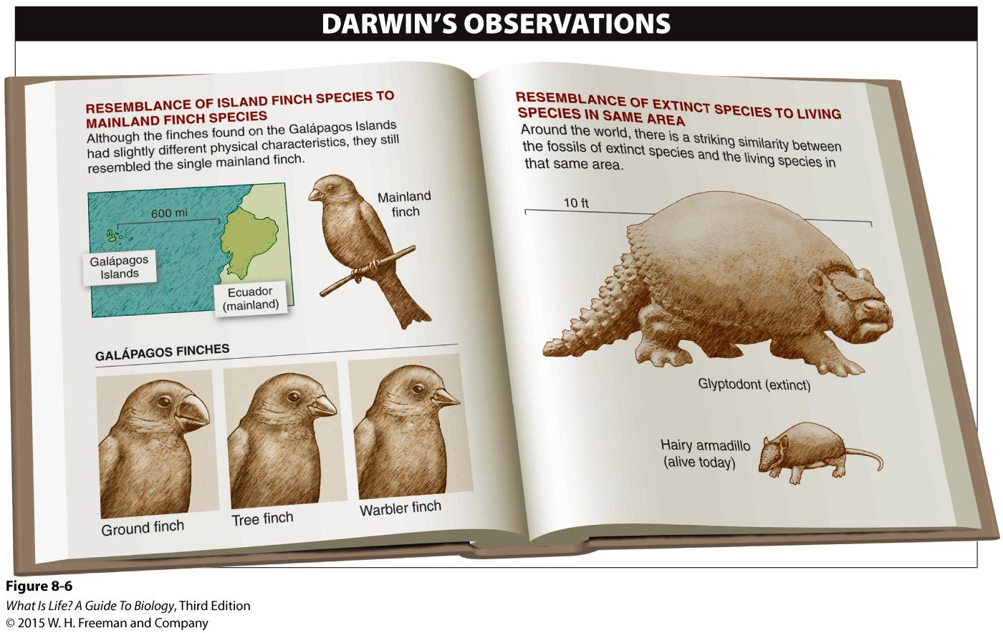
2 Important Patterns:
1st: Darwin’s finches
2nd: Fossil resemblance to living organisms
Notes:
Regarding #1: The staff of the Zoological Society, to whom Darwin sent the specimens, could see from the birds’ physical differences that the birds were not reproductively compatible and that there were 13 unique lineages—a different species for every one of the Galápagos Islands that Darwin had visited. Moreover, although the birds were different species, they all resembled very closely the single species of finch living on the closest mainland, in Ecuador.
This resemblance seemed a suspicious coincidence to Darwin. Perhaps the island finches resembled the mainland species because they used to be part of the same mainland population. Over time they may have separated and diverged from the original population and gradually formed new—but similar— species. Darwin’s logic was reasonable, but his idea flew in the face of all the scientific thinking of the day.
Regarding #2: In Argentina, he found some giant fossils from a group of organisms called “glyptodonts.” The extinct glyptodonts looked just like armadillos, a species that still flourished in the same area. Or rather, they looked like armadillos on steroids: the average armadillo today is about the size of a house cat and weighs 10 pounds, while the glyptodonts were giants at 10 feet long and more than 4,000 pounds.
If glyptodonts had lived in South America in the past, and armadillos were currently living there, why was only one of the species still alive? And why were the glyptodont fossils found only in the same places where modern armadillos lived? Darwin deduced that glyptodonts resembled armadillos because they were their ancient relatives. Again, it was a logical deduction, but it contradicted the scientific dogma of the day that species were unchanging and extinction did not occur.

Slide 8
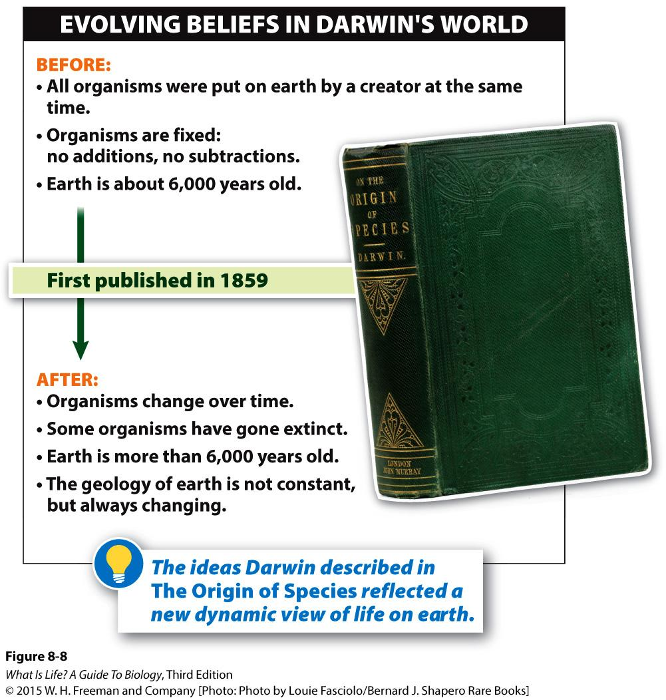
Darwin’s Theory of Evolution
Essay on the Principle of Population by Thomas Malthus
1st draft, 35 pages
The Origin of the Species
Changed the way we think about the world
Notes:
Inspiration struck when Darwin was reading “for amusement” Essay on the Principle of Population, by the economist Thomas Malthus. Darwin speculated that, rather than the future holding certain catastrophe for all, maybe the best individuals would “win” in the ensuing struggle for existence, and the worst would “lose.” If so, he suddenly saw that “favourable variations would tend to be preserved, and unfavourable ones to be destroyed.”

Slide 9
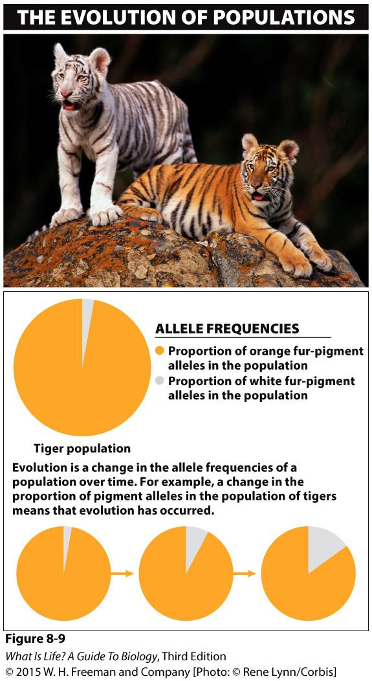
Populations Evolve
White tigers at a zoo
Breeding
Trading
Populations evolve, not individuals
Notes:
‹#›
Suppose you were put in charge of a large population of tigers in a zoo. Virtually all of them are orange and brown with black stripes. Occasionally, though, unusual all-white tigers are born. This white phenotype is the result of possessing a rare pair of alleles that suppresses the production of most fur pigment (Figure 8-9 Evolution defined).
Because visitors flock to zoos to see the white tigers, you want to increase the proportion of your tiger population that is white.
How would you go about doing that?

Slide 10
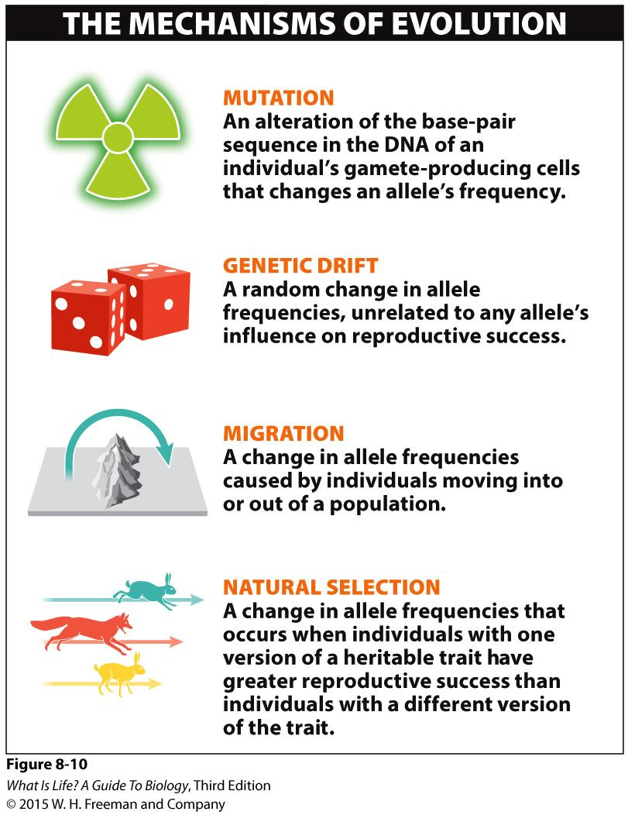
Mechanisms of Evolution
Mutation
Genetic drift
Migration
Natural selection
Notes:
The 4 evolutionary mechanisms are:
1. Mutation
2. Genetic drift
3. Migration
4. Natural selection
Keeping in mind that evolution is genetic change in a population, we’ll now explore each of these four forces, which are all capable of causing such genetic changes.

Slide 11
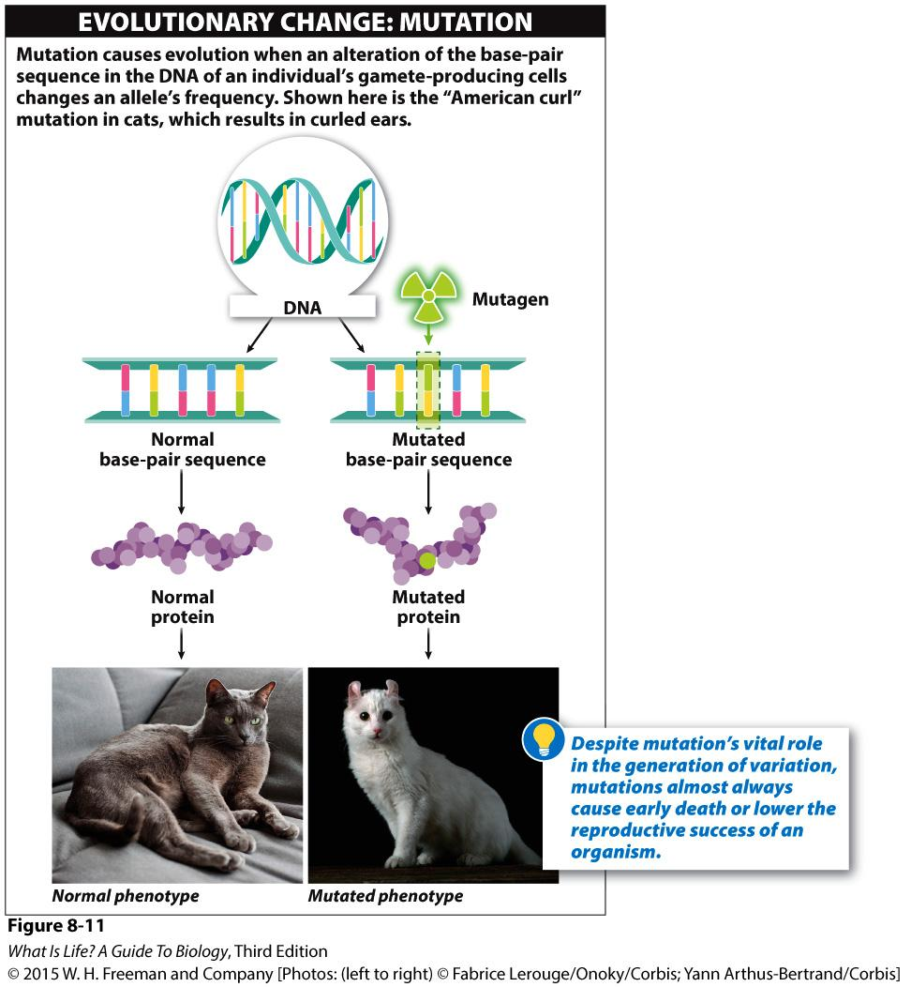
Mutations
Alteration of the base-pair sequence of an individual’s DNA
Only really matters in reproductive cells
Occur during cell division
Notes:
‹#›
In describing the first of the four mechanisms of evolution, it is helpful to keep our precise definition of evolution in mind: a change in the allele frequencies found in a population.
Mutation is an alteration of the base-pair sequence of an individual’s DNA, and when this alteration occurs in a section of the DNA that codes for a particular gene, the change in the DNA sequence may change the allele.
Say, for example, that a mutation changes one of the two blue-eye alleles that an individual possesses into a brown-eye allele.
If this mutation occurs in the sperm- or egg-producing cells, it can be passed on to the next generation; the offspring may be born carrying the brown-eye allele.
When this happens, the proportion of blue-eye alleles in the population—i.e. their market share, is slightly reduced, and the market share of brown-eye alleles is slightly increased. Evolution has occurred.

Slide 12
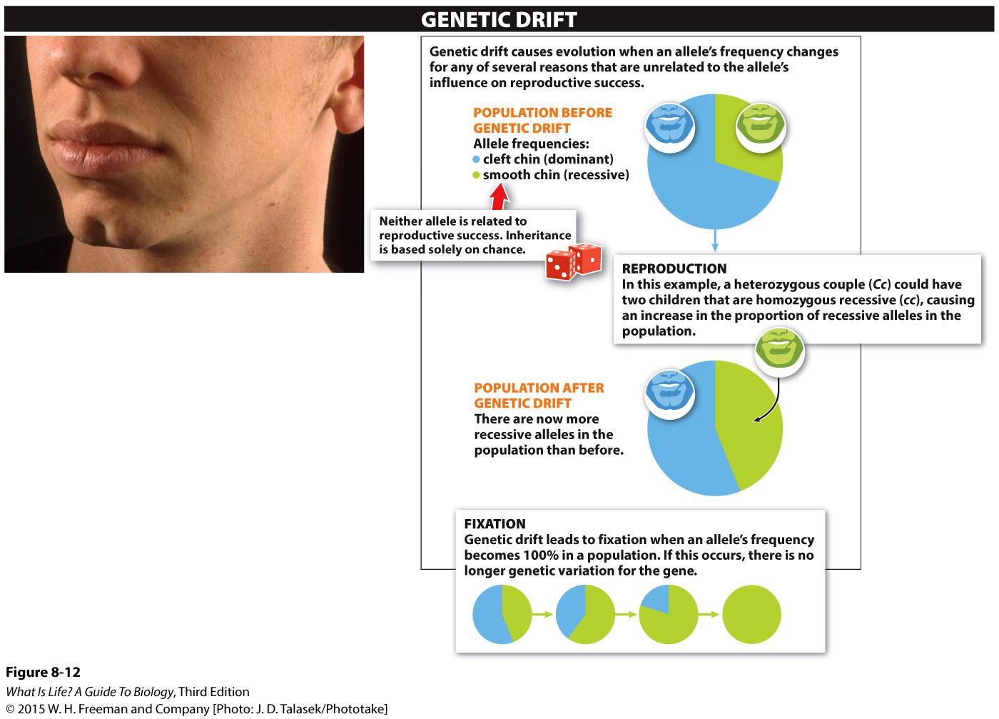
Genetic Drift
2 special cases
Founder Effect
Bottleneck Effect
Notes:
‹#›
Imagine that in a population there are two alleles present for a particular trait such as a cleft chin.
It is a dominant trait, so individuals with either one or two copies of the dominant allele (CC or Cc) exhibit the cleft chin.
Now suppose that two heterozygous (Cc) people have one child.
Which combination of alleles will that child receive?
It is impossible to predict because it depends completely upon which sperm fertilizes which egg—the luck of the draw.
If their sole child inherited a recessive allele from each parent, would the population’s allele frequencies be different?
Yes. After all, there is now another individual in the population, and that individual has two recessive alleles (cc). There are slightly more recessive alleles in the population. And because a change in allele frequencies has occurred, evolution has happened.
It is equally likely that this couple’s only child would have received two of the dominant alleles (CC), rather than the recessive alleles.
In either case, because a change in allele frequencies has occurred, evolution has happened.
The Bottleneck Effect occurs when there is a disaster of some sort that reduces a population to a small handful, which rarely represents the actual genetic makeup of the initial population. This leaves smaller variation among the surviving individuals
The founder effect is when a few individuals in a population colonize a new location that's separate from the old population. This also greatly reduces the population size, as well as reduces the genetic variability of the population.

Slide 13
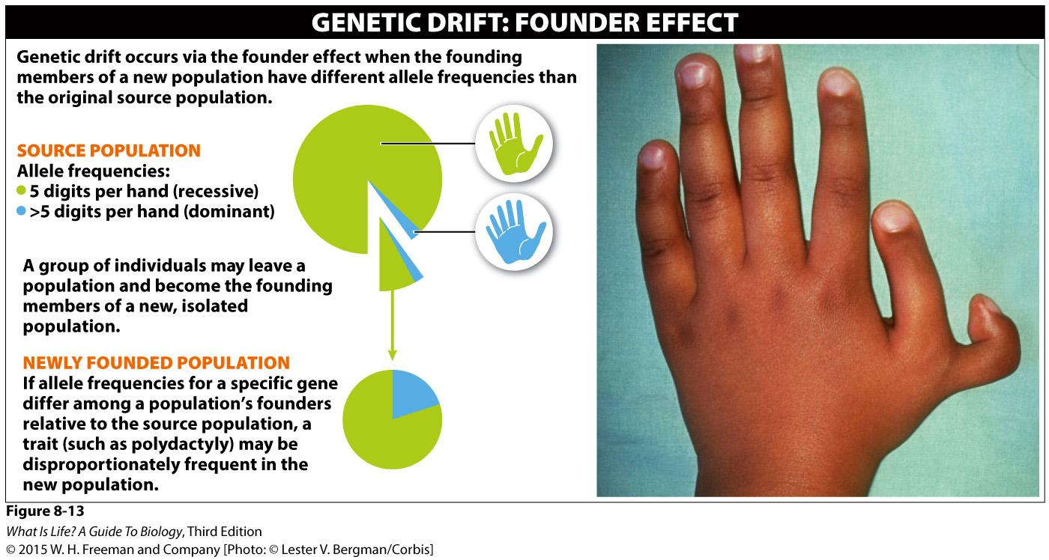
Founder Effect
Small number of individuals start a new, isolated population
Notes:
‹#›
Founder effect
A small number of individuals may leave a population and become the founding members of a new, isolated population. The founders may have different allele frequencies than the original “source” population, particularly if they are a small sample. If they have different allele frequencies, there has been evolution.
Because the founding members of the new population will give rise to all subsequent individuals, the new population will be dominated by genetic features that happened to be present in those founding fathers and mothers. This type of genetic drift is called the founder effect.

Slide 14
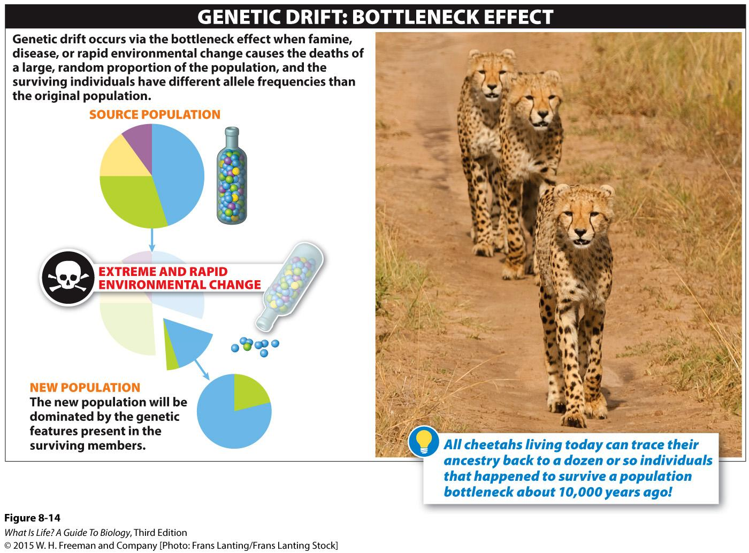
Population Bottlenecks
Notes:
‹#›
Occasionally, a famine, disease or rapid environmental change may cause the deaths of a large proportion (sometimes as much as 90% or more) of the individuals in a population.
Because the population is reduced to a small fraction of its original size, this reduction is called a bottleneck. If the catastrophe is equally likely to strike any member of the population, the remaining members are essentially a random small sample of the original population. For this reason, they may not possess the same allele frequencies as the original population. Thus, the consequence of such a population bottleneck would be evolution through genetic drift.
Just such a population bottleneck occurred in the cheetah near the end of the last ice age, about 10,000 years ago.
Although the cause is unknown—possibly environmental cataclysm or human hunting pressures—it appears that nearly all cheetahs died. Although the population has rebounded, all cheetahs living today can trace their ancestry back to a dozen or so lucky individuals that survived the bottleneck. As a result of this past instance of evolution by genetic drift, there is almost no genetic variation left in the current population of cheetahs. (And, in fact, a cheetah will accept a skin graft from any other cheetah much as identical twins will.)

Slide 15
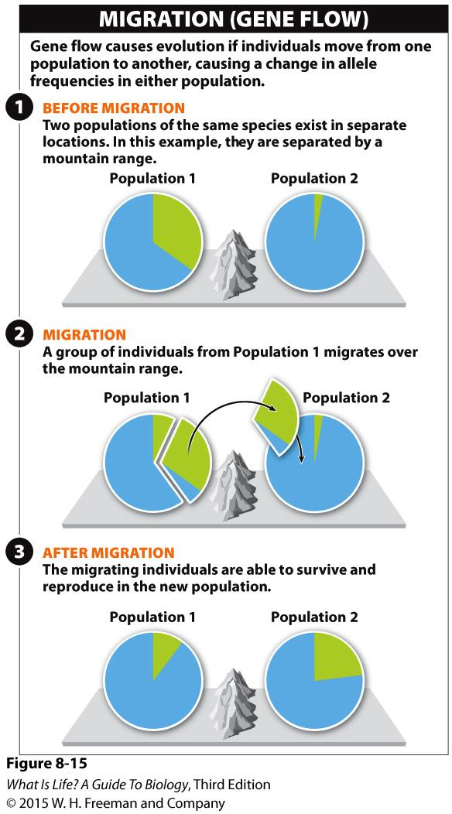
Migration
The movement of some individuals of a species from one population to another
Dependent on mobility and barriers
Notes:
This movement from population to population within a species distinguishes migration from the founder effect, in which individuals migrate to a new habitat, previously unpopulated by that species.
If migrating individuals can survive and reproduce in the new population, and also carry a different proportion of alleles than the individuals in their new home, then the recipient population experiences a change in allele frequencies and, consequently, experiences evolution.
And because alleles are simultaneously lost from the initial population, that population too will experience a change in its allele frequencies.

Slide 16
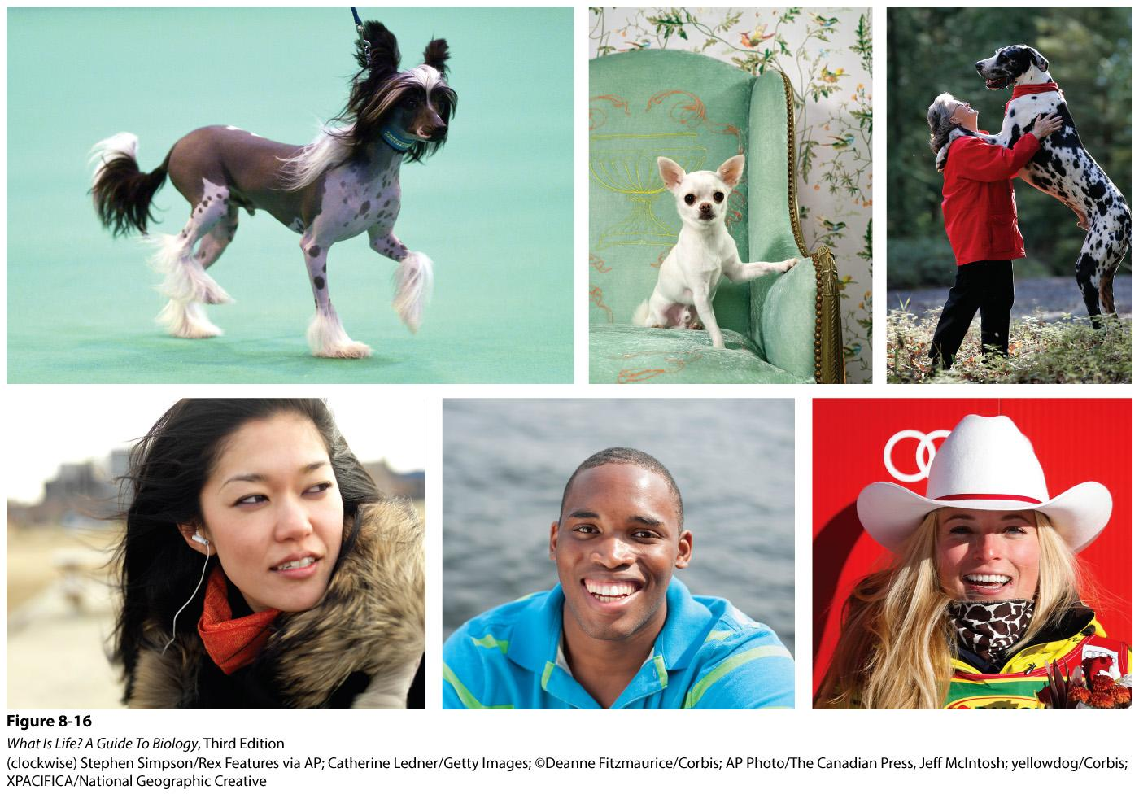
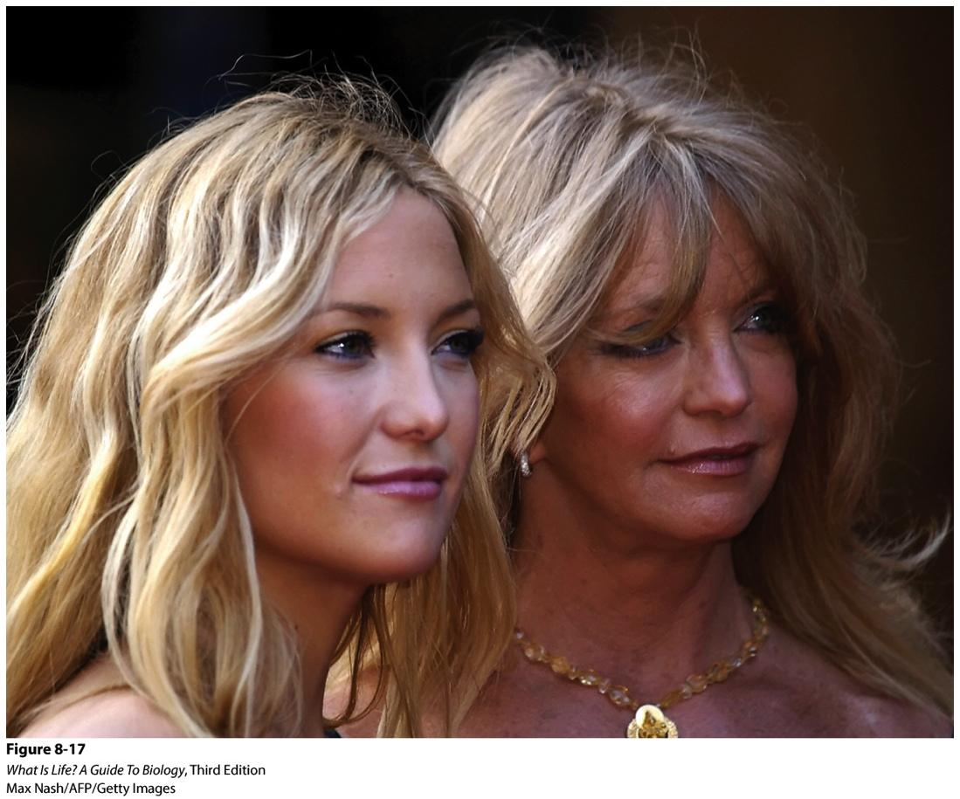
Natural Selection
Three conditions required:
Variation within a population.
Variation must be inheritable.
Differential reproductive success
Notes:
‹#›
The fourth agent of evolutionary change is natural selection.
This is the mechanism that Darwin identified in The Origin of Species, in which he noted that three conditions are necessary for natural selection to occur.
Let’s examine these conditions more closely.

Slide 17
Differential Reproductive Success
Darwin’s 3 observations:
There are more organisms born than can survive.
Organisms are continually struggling for existence.
Some organisms are more likely to win this struggle and survive and reproduce.
Notes:
‹#›
Darwin derived the third condition of natural selection from three fairly simple observations that he made.

Slide 18
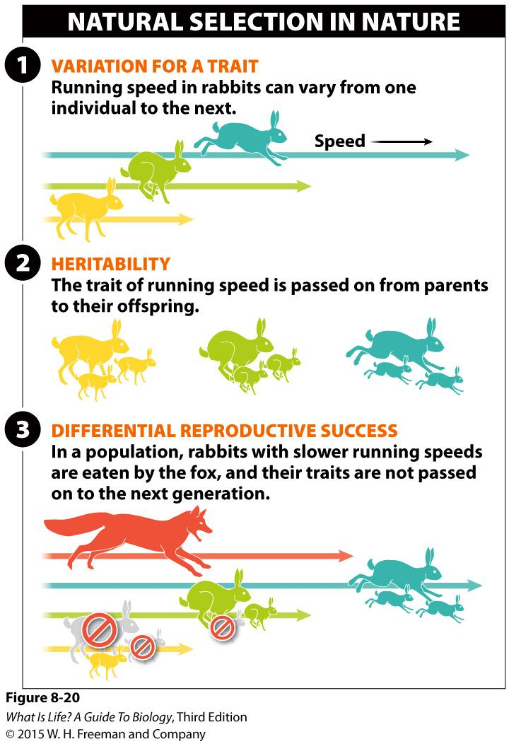
Natural Selection in Nature
Variation for a trait
Heritability
Differential reproductive success
Notes:
‹#›
If you carry a trait that makes you a slower running rabbit, for example, you are more likely to be eaten by the fox (Figure 8-20 Removing the losers).
If running speed is a heritable trait (and it is), the next generation in a population contains fewer slow rabbits.
Over time, the population is changed by natural selection.
It evolves.

Slide 19
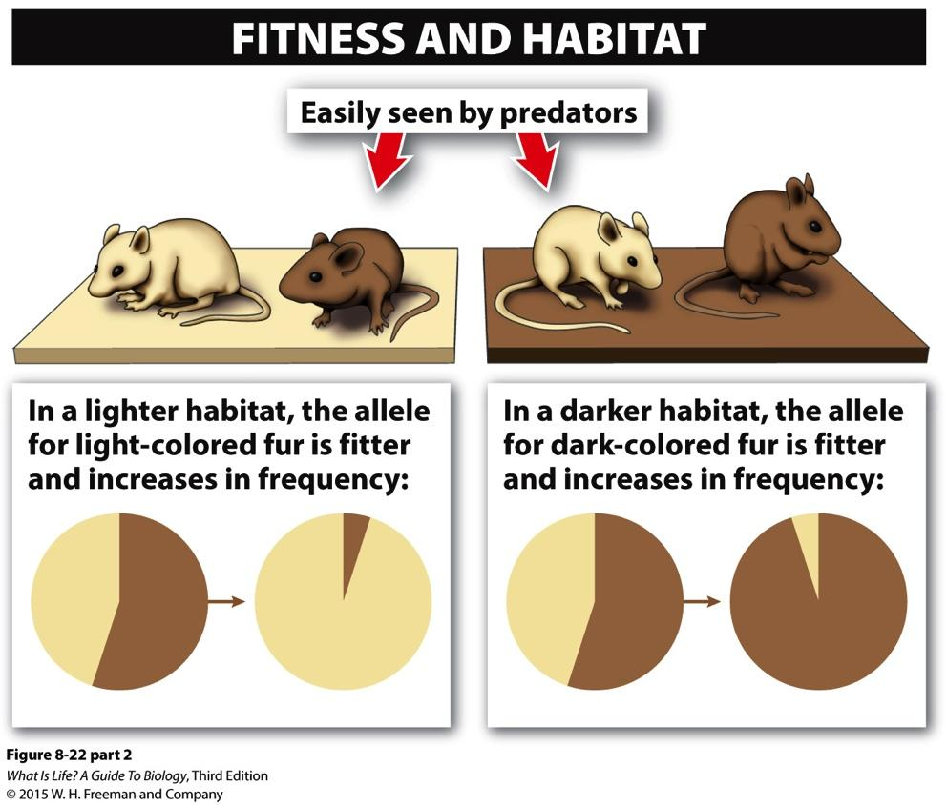
Fitness
A measure of an organism’s reproductive success
3 important elements:
Relative to other genotypes or phenotypes in the population
Depends on the specific environment.
Depends on an organism’s reproductive success compared to other organisms.
Notes:
‹#›
Fitness has everything to do with an organism’s reproductive success.

Slide 20
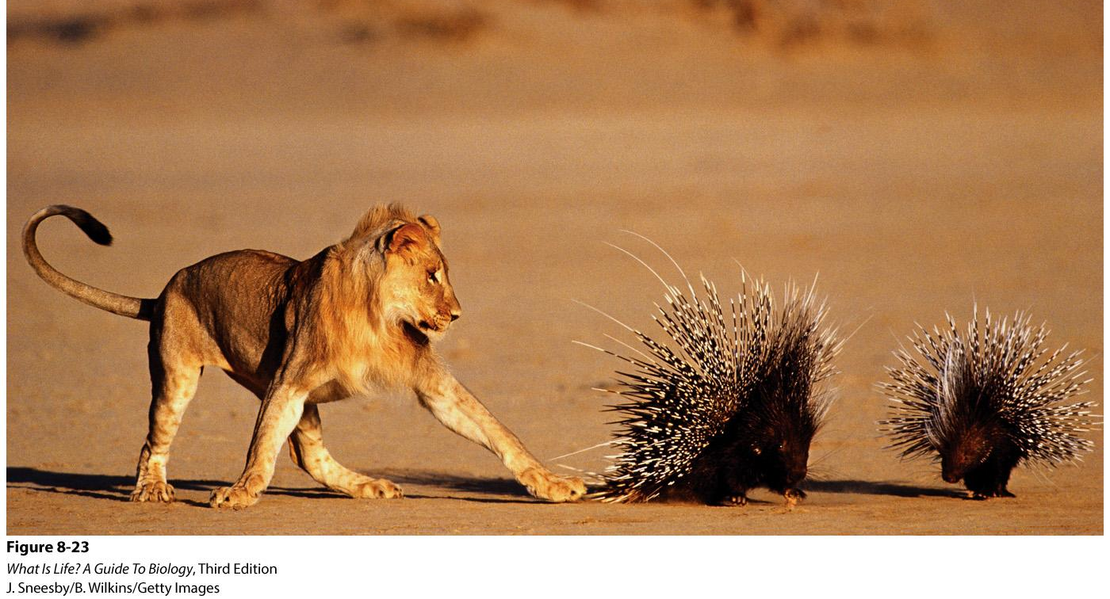
Adaptation
The process by which organisms become better matched to their environment & the specific features that make an organism more fit
Notes:
‹#›
As Darwin noted over and over again during his travels, the organisms that possess traits that allow them to better exploit the environment in which they live will tend to produce more offspring than the organisms with alternative traits.
With passing generations, a population will be made up of more and more of these more fit organisms.
And, as a consequence, organisms will tend to be increasingly well-matched or adapted to their environment.
Adaptation refers to both the process by which organisms become better matched to their environment and the specific features that make an organism more fit. Examples of adaptations abound. Bats have an extremely accurate type of hearing (called echolocation) for navigating and finding food, even in complete darkness. Porcupine quills make porcupines almost impervious to predation (Figure 8-23 Adaptations increase fitness).

Slide 21
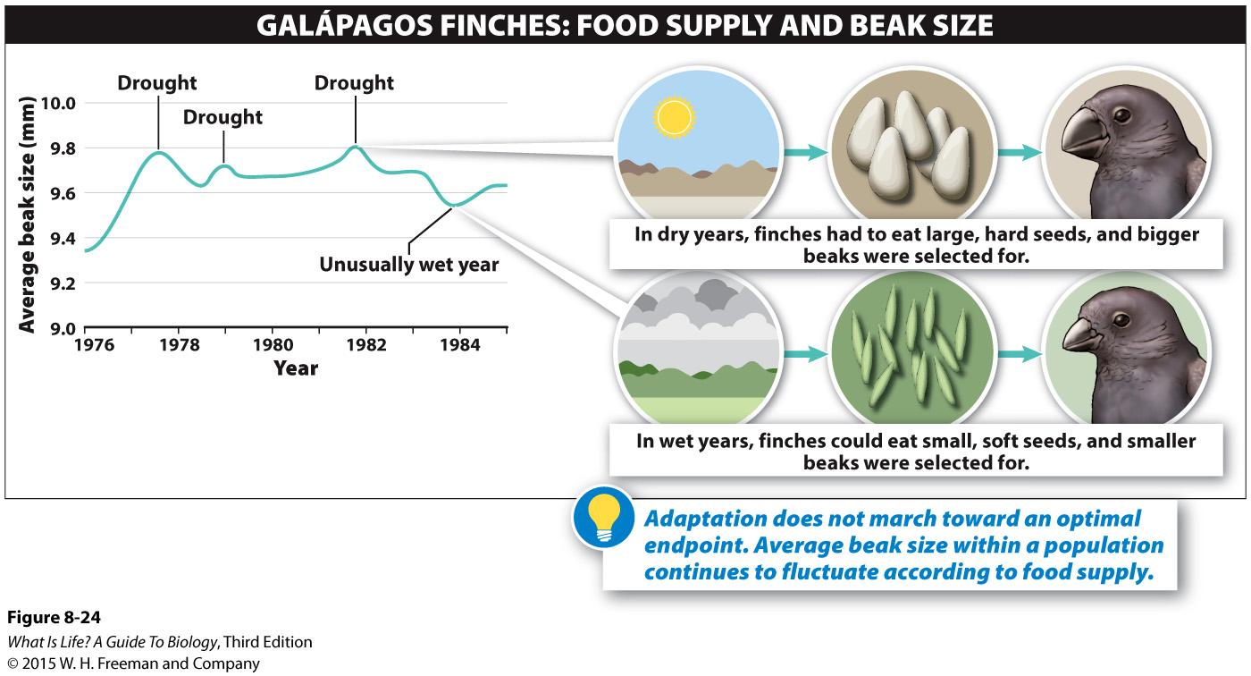
Perfect Organisms Don’t Exist
Constant changing environments don’t produce perfection
Notes:
Consider one of the many clearly documented cases of evolution occurring: that of the beak size of Galapagos finches.
Over the course of a multi-decade study, the biologists Rosemary and Peter Grant closely monitored the average size of the finches’ beaks. They found that the average beak size fluctuated according to the food supply. During dry years—when the finches had to eat large, hard seeds—bigger, stronger beaks became the norm. During wet years, smaller beaked birds were more successful since there was a surplus of small softer seeds. The ever-changing “average” finch beak illustrates that adaptation does not simply march toward some optimal endpoint.

Slide 22
Prevention of Perfection
3 factors that prevent perfection:
Environments change quickly.
Variation is needed as the raw material of selection.
There may be multiple different alleles for a trait, each causing an individual to have the same fitness.
Notes:
‹#›
Several different factors prevent populations from progressing inevitably toward perfection:
Environments change quickly.
Natural selection may be too slow to adapt the organisms in a population to the constantly moving target of the environment.
Variation is needed as the raw material of selection—remember, it is the first necessary condition for natural selection to occur.
If a mutation creating a new, “perfect” version of a gene never occurs, the individuals within a population will never be perfectly adapted. Why, for instance, are there no mammals with wheeled appendages? That might be a great trait, but until the genes for it exist, natural selection cannot increase their market share in the population.
There may be multiple different alleles for a trait, each causing an individual to have the same fitness.
In this case, each allele represents an equally fit “solution” to the environmental challenges.

Slide 23
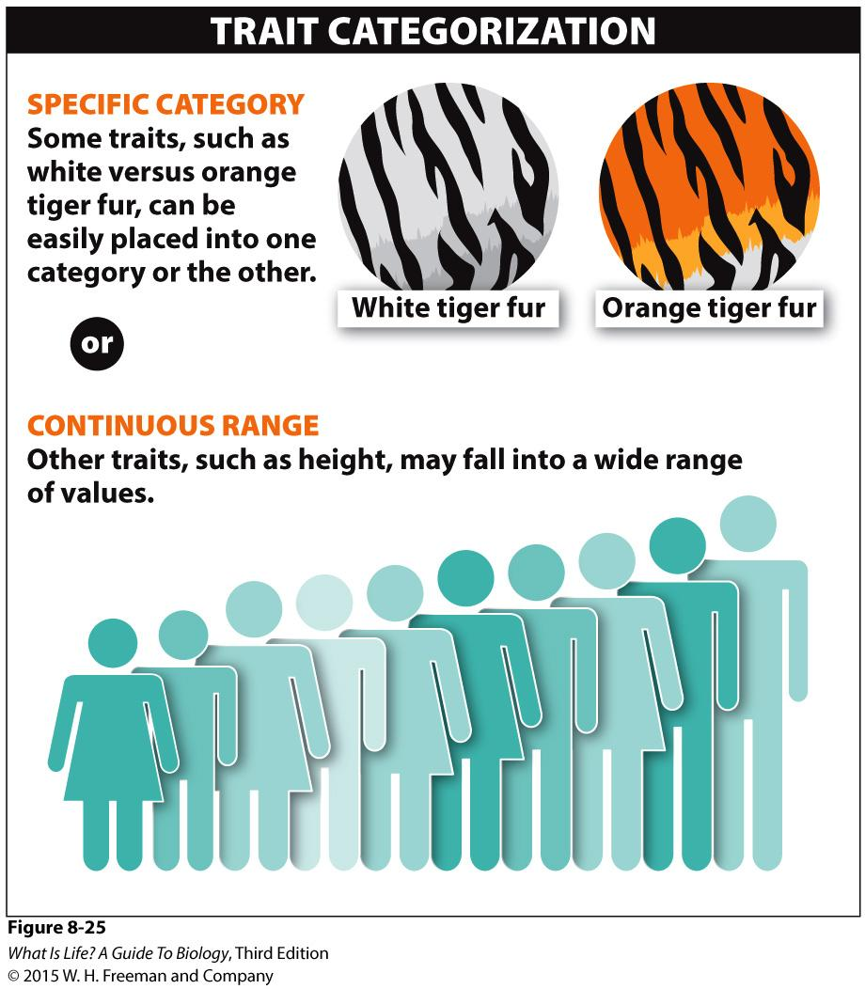
Trait Categorization
Simple
Complex
3 major categories:
Directional selection
Stabilizing selection
Disruptive selection
Notes:
‹#›
Certain traits fall into easy categories—some people have blue eyes and others have brown eyes, just as some tigers have white fur and some have orange fur.
Other traits, such as height in humans, are influenced by many genes and environmental factors so that a continuous range of phenotypes occurs (Figure 8-25 Some traits fall into clear categories, others range continuously).
Whether a given trait is influenced by one gene or a complex interaction of many genes and the environment, it can be subject to natural selection and be changed in any of several ways.

Slide 24
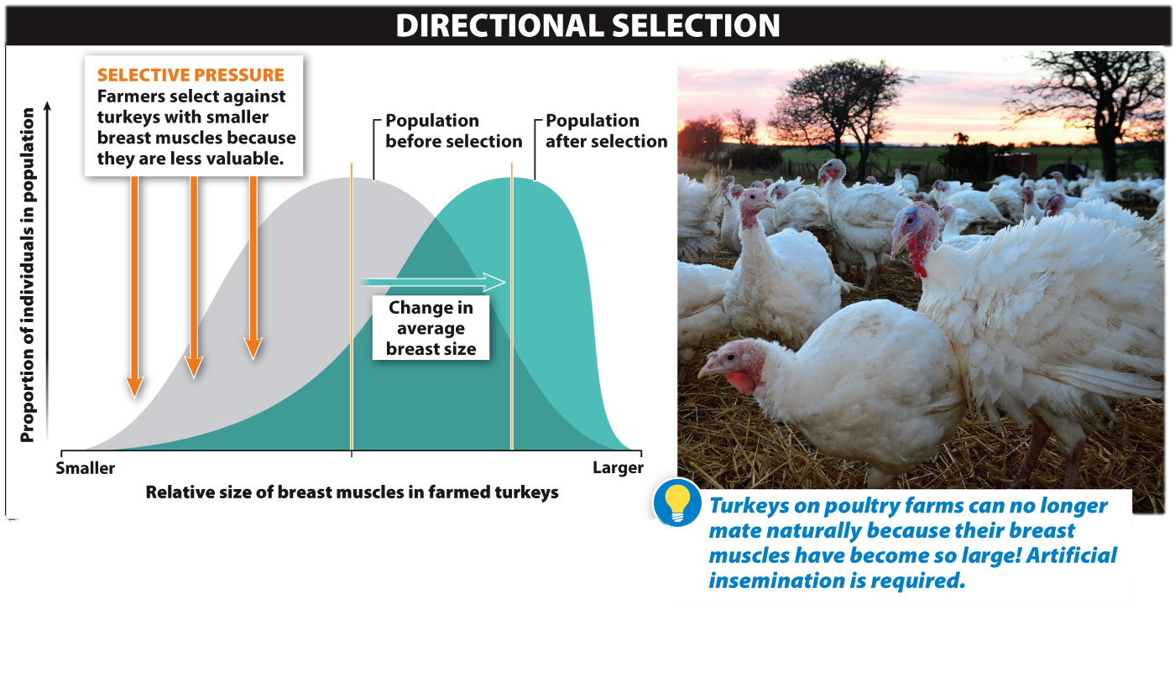
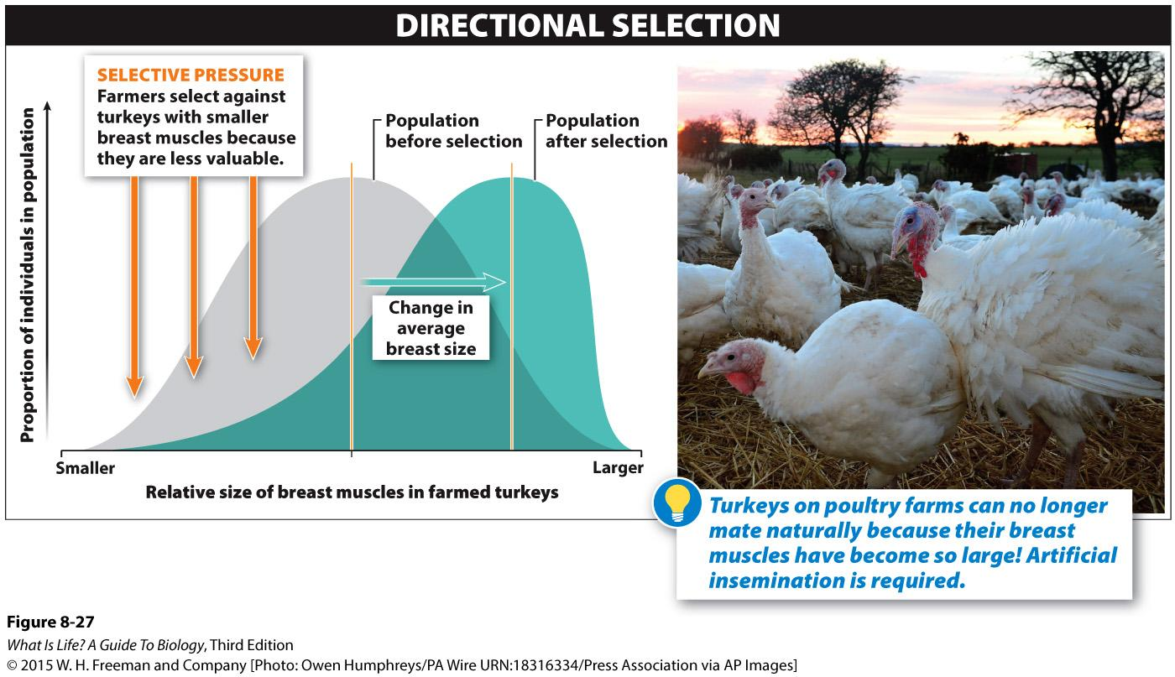
Directional Selection
Individuals with one extreme from the range of variation in the population have higher fitness.
Selectively breeding for large milk production
Selectively breeding for large breasts in turkeys
Notes:
‹#›
In directional selection, individuals with one extreme from the range of variation in the population have higher fitness.
Milk production in cows is an example. There is a lot of variation in milk production from cow to cow. As you might expect, farmers select those cows with the highest milk production for breeding and have done so for many decades. The result of such selection is not surprising: between 1920 and 1945, average milk production increased by about 50% in the United States. Those at the other end of the range, the cows that produce the smallest amounts of milk, have reduced fitness—since the farmers do not allow them to reproduce and therefore contribute their “less milk” alleles to the subsequent generation.

Slide 25
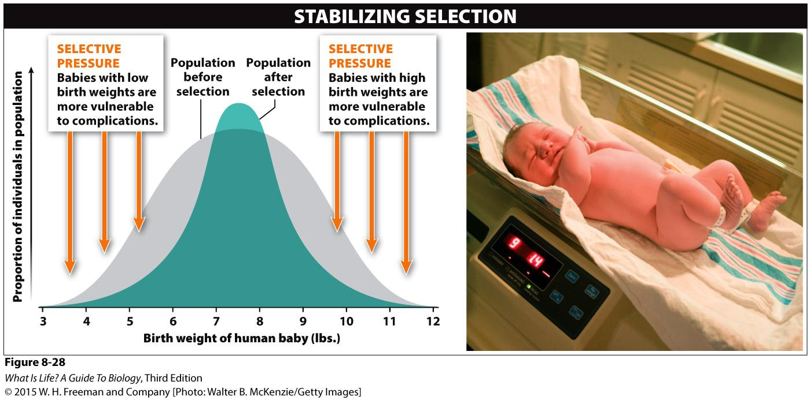
Stabilizing Selection
Individuals with intermediate phenotypes are most fit.
Notes:
‹#›
How much did you weigh at birth? Was it more than ten pounds? More than eleven? Was it close to the 22 and a half pounds that Christina Samane’s child weighed when born in South Africa in 1982? Or was it five pounds or less?
Unlike directional selection, for which there is increased fitness at one extreme and reduced fitness at the other, stabilizing selection occurs when individuals with intermediate phenotypes are most fit. The death rate among babies, for example, is lowest between seven and eight pounds, rising among both lighter and heavier babies (Figure 8-28 Patterns of natural selection: stabilizing selection). This outcome has kept the average weight of a baby constant over many generations but at the same time, the variation in birth weight has decreased as stabilizing selection has reduced the frequencies of those genes associated with high and low birth weights.

Slide 26
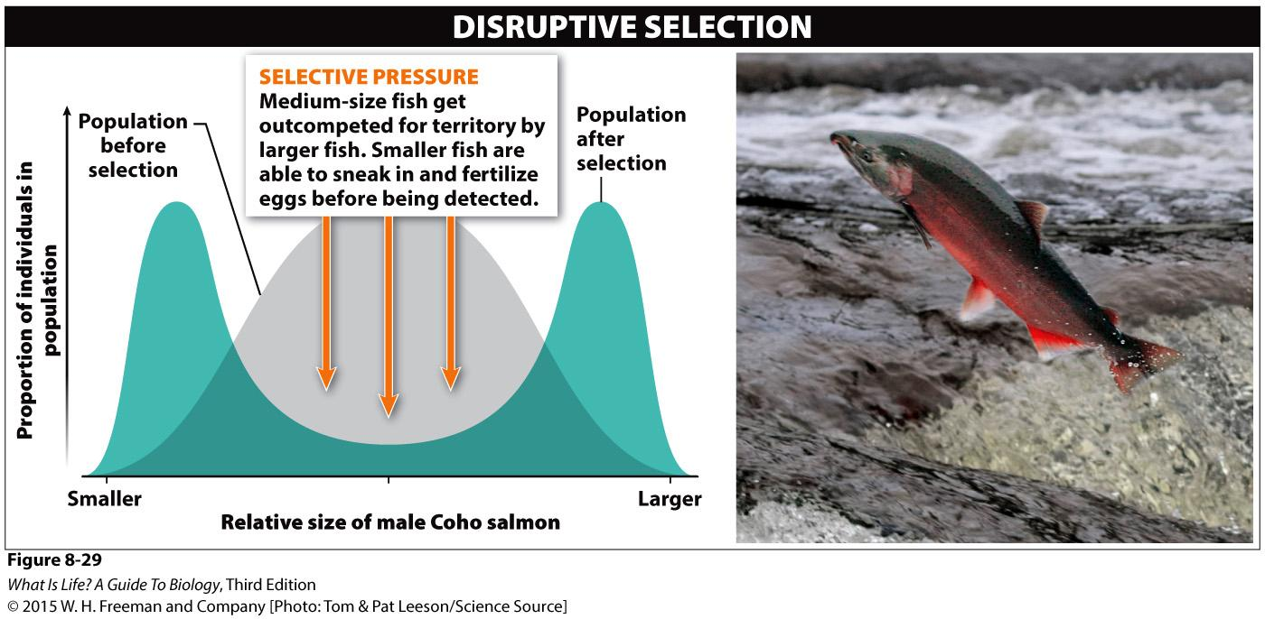
Disruptive Selection
Individuals with extreme phenotypes experience the highest fitness, and those with intermediate phenotypes have the lowest.
Notes:
‹#›
There is a third kind of natural selection, in which individuals with extreme phenotypes experience the highest fitness and those with intermediate phenotypes have the lowest.
Although examples of this type of selection, called disruptive selection, are rare in nature, the results not surprising. Among some species of fish, the Coho salmon for instance, only the largest males acquire good territories. They generally enjoy relatively high reproductive success. While the intermediate-sized fish regularly get run out of the good territories, some tiny males are able to sneak in and fertilize eggs before the territory owner detects their presence. Consequently, we see an increase in the frequency of small and large fish with a reduction in the medium-sized fish (Figure 8-29 Patterns of natural selection: disruptive selection).

Slide 27
Notes:
Answer: 4

